Slide 1
Geometry of Matrix Operators in R^2

Slide 2
Transformations of Regions
Effect that a matrix operator has on individual vectors.
How operators affect the shape of regions enclosed by these vectors

Slide 3
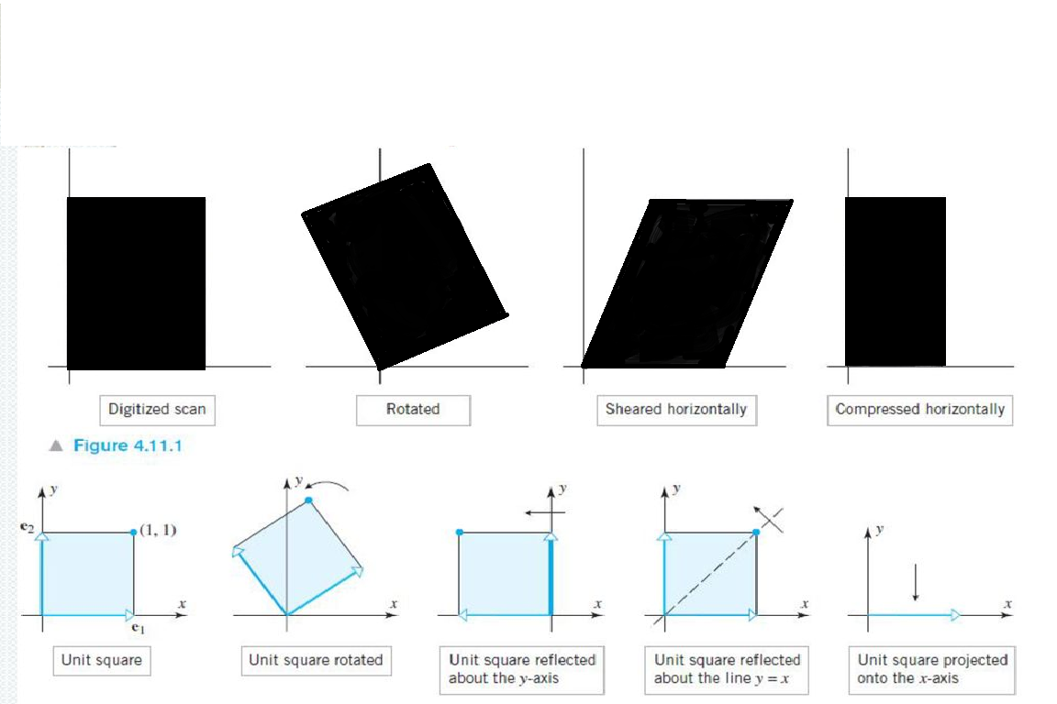

Slide 4
Transforming with diagonal matrices
Suppose that x-y plane first is compressed or expanded by a factor of k1 in the x-direction and then is compressed or expanded by a factor of k2 in the y direction.
Objective : to find a single matrix operator that performs both operations
Standard matrix for the 2 operations are :
X : k1 0 Y : 1 0
0 1 0 k2

Slide 5
Thus , the standard matrix for the compression/expansion along both x and y axis is :
    A = 1 0 k1 0 = k1 0
    0 k2 0 1 0 k2

Slide 6
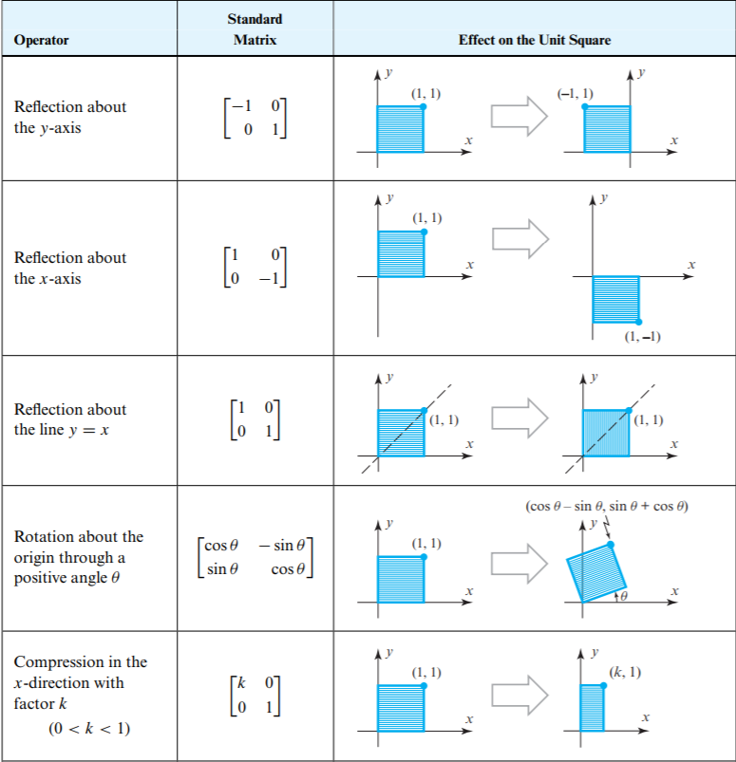

Slide 7
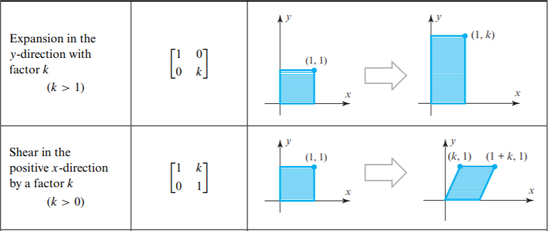
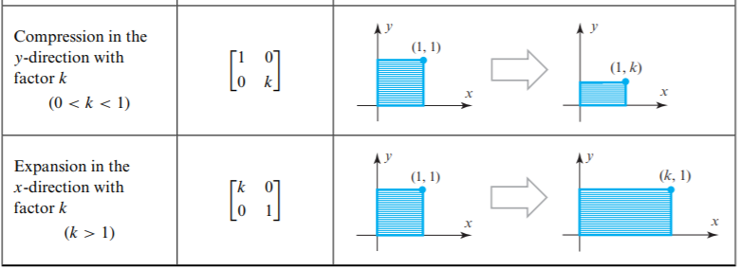

Slide 8
Finding matrix operators

Slide 9
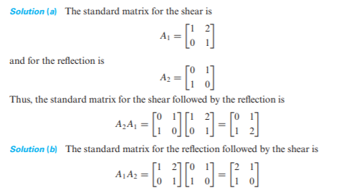

Slide 10
Geometry of one to one matrix operators
One to one matrix operators : map distinct points into distinct points.i.e,a matrix transformation Ta is one to one iff A can be expressed as a product of elementary matrices.
To analyse effect of one to one transformation,factor the matrix A into product of elementary matrices
A = E1 * E2 *……… * En
From this; Ta=T e1*Te2*……Ten

Slide 11
Conclusions :
If E is an elementary matrix , then Te is one of the following
A shear along a coordinate axis
A reflection about y=x
A compression along a coordinate axis
An expansion along a coordinate axis
A reflection about a coordinate axis
A compression or expansion along a coordinate axis followed by a reflection about a coordinate axis.

Slide 12
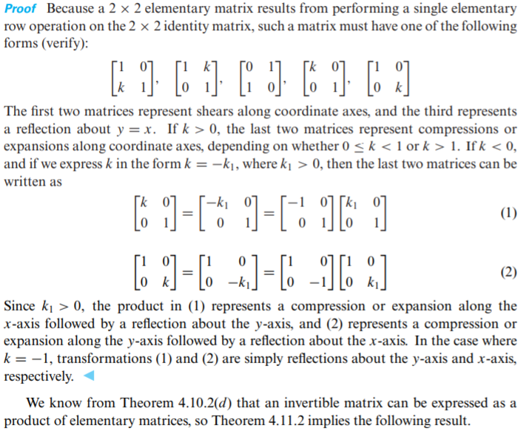

Slide 13
Decomposing a Matrix operator
consider the matrix A = 0 1
2 1
In order to trace the geometrical tranformations in converting this matrix to a identity matrix,we must find the elementary matrices of each step

Slide 14
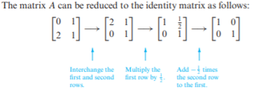
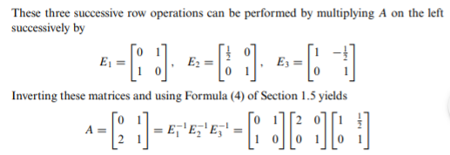

Slide 15
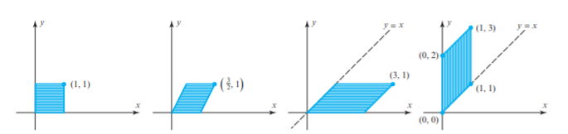
Reading from right to left , we can now see that the geometric effect of multiplying by A is equivalent to successively
Shearing by a factor of ½ in the x-direction
Expanding by a factor of 2 int the x direction
Reflecting about the line y=x

Slide 16
THEOREM :
If T a : R^2 -> R^2 is a multiplication by an invertible matrix A ,then the geometric effect of Ta is the same as appropriate succession of shears , compressions , expansions and reflections

Slide 17
Image of a line
A = 3 1
2 1 maps the line y=2x+1 into another line.find its equation
Solution : (x,y) be point on y=2x+1 and let (x’,y’) be its image under multiplication by A
x’ = 3 1 x x = 3 1 -1 x’ = 1 -1 x’
y’ = 2 1 y y = 2 1 y’ -2 3 y’
Obtain x,y and substitute in y=2x+1

Slide 18
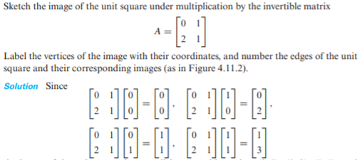
Transformation of unit square
The image of the unit square is a parallelogram with vertices (0.0),(0,2),(1,1) and (1,3)

Slide 19
THANKYOU

